Slide 1
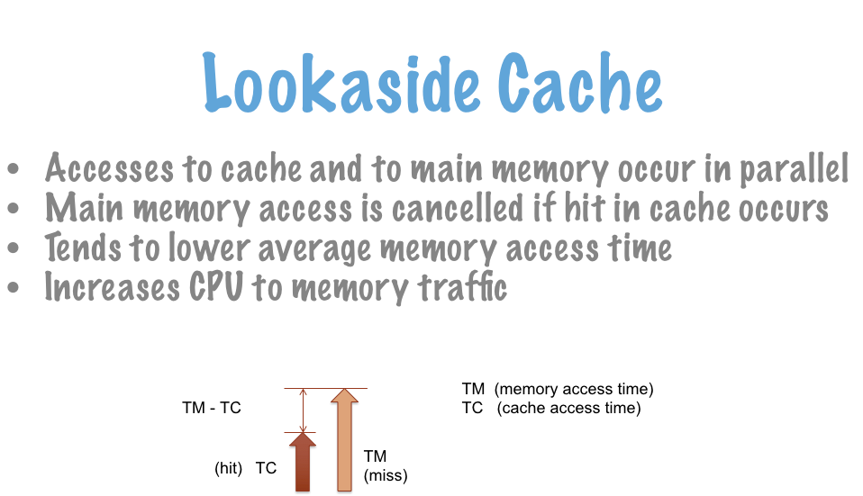
Lookaside Cache

Slide 2
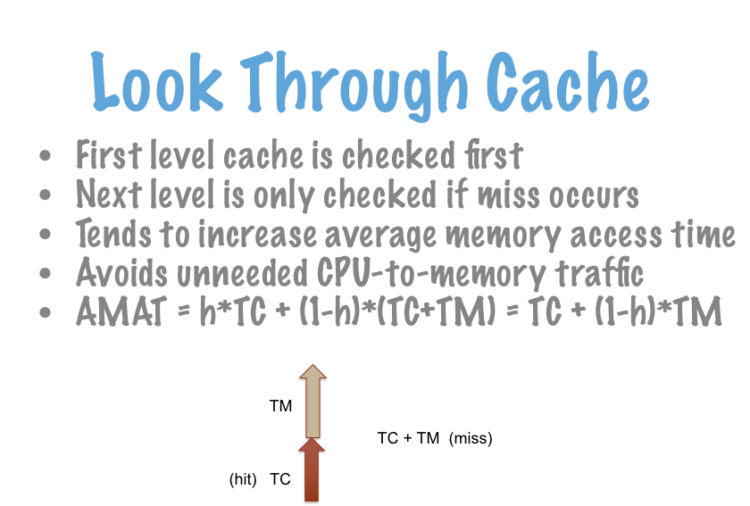
Look Through Cache

Slide 3
Example Problem
Consider a memory system with a 20ns access time supported by a cache with a 5ns access time and a hit rate of 90%
What is the average memory access time for a lookaside cache?
What is the average memory access time for a look through cache?

Slide 4
Example Problem Answer
Consider a memory system with a 20ns access time supported by a cache with a 5ns access time and a hit rate of 90%
What is the average memory access time for a lookaside cache?
What is the average memory access time for a look through cache?
AMAT = 5*0.9 + 20*0.1 = 4.5+2 = 6.5ns
AMAT = 5 + 20*0.1 = 5+2 = 7ns

Slide 5
Example Problem 2
Consider a memory system with a 20ns access time supported by a L1 cache with a 5ns access time and a hit rate of 90% and an L2 cache with an 8ns access time and a hit rate of 80%
What is the average memory access time for a lookaside cache?
What is the average memory access time for a look through cache?

Slide 6
Example Problem 2 Answer
Consider a memory system with a 20ns access time supported by a L1 cache with a 5ns access time and a hit rate of 90% and an L2 cache with an 8ns access time and a hit rate of 80%
What is the average memory access time for a lookaside cache?
What is the average memory access time for a look through cache?
AMAT = 5*0.9 + 0.1*(8*0.8 + 20*0.2) = 4.5 + 0.1*(6.4+4) = 4.5 + 1.04 = 5.54 ns
AMAT = 5 + 0.1*(8 + 20*0.2) = 5 + 0.1*(8+4) = 5 + 1.2 = 6.2 ns

Slide 7
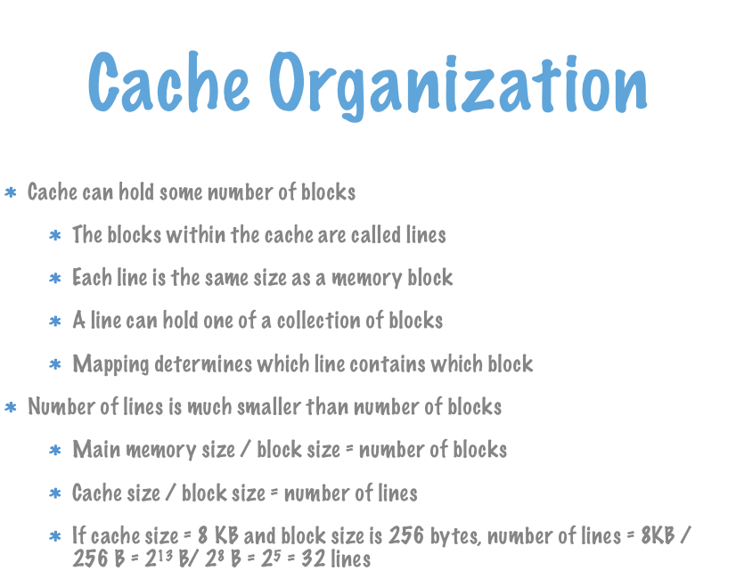
Cache Organization

Slide 8
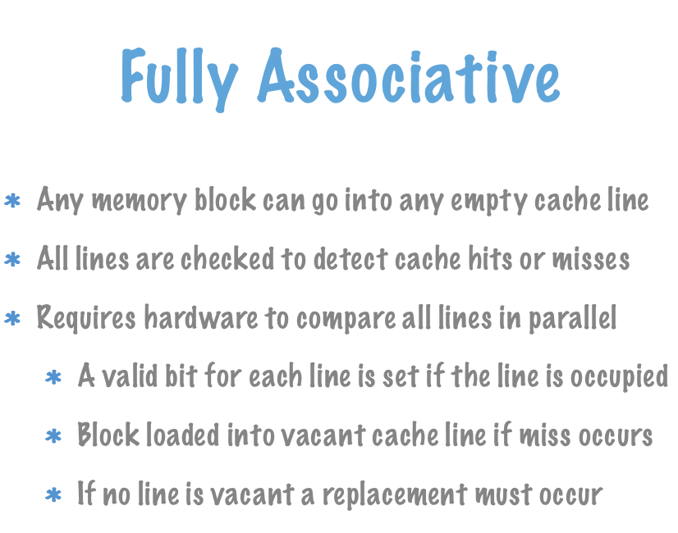
Fully Associative

Slide 9
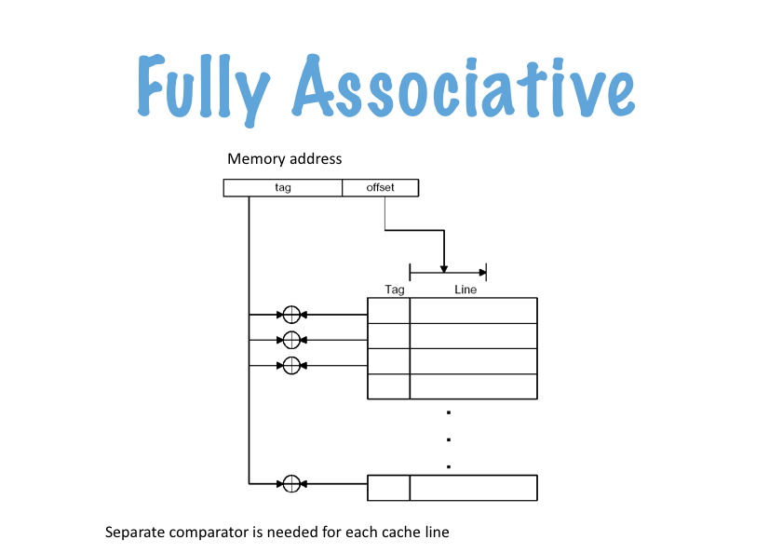
Fully Associative

Slide 10
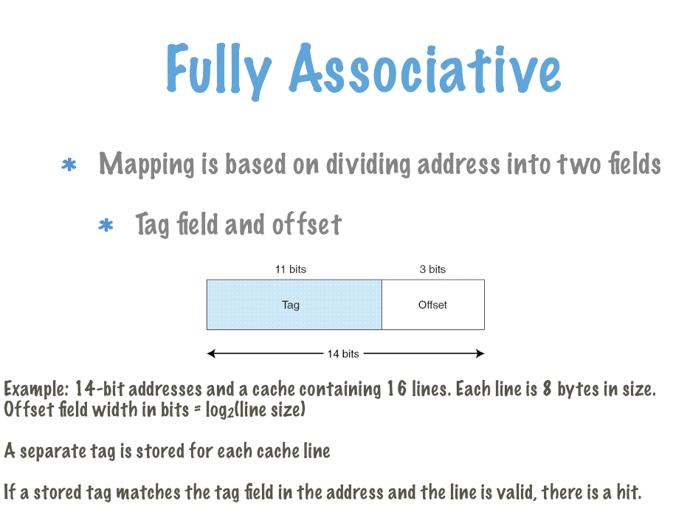
Fully Associative

Slide 11
Example Problem 3
A system has a main memory of 2¹⁶ bytes and a fully associative cache that is 2⁶ bytes. The block size is 2³ bytes.
How many bits are in an address?
How many lines are in the cache?
What is the size of the offset field?
What is the size of the tag field?

Slide 12
Example Problem 3 Answer
A system has a main memory of 2¹⁶ bytes and a fully associative cache that is 2⁶ bytes. The block size is 2³ bytes.
How many bits are in an address? 16 bits
How many lines are in the cache? 2⁶ bytes/cache / 2³ bytes/line = 2³ lines/cache
What is the width of the offset field? log(2³) = 3 bits
What is the width of the tag field? 16-3 = 13 bits

Slide 13
Example Problem 4
Line | Tag | Data
0 | 0100101000001 | 0xABCDABCD0134D4E3
1 | 1011010011000 | 0x0122E4FAB237910A
2 | 1011001001001 | 0x01332E4F7A37910A
3 | 1100101010101 | 0x013325698AC7910C
4 | 1010101010101 | 0xABCD1298AC7910CA
5 | 1101101101000 | 0x214FAB237910A2C9
6 | 1011101101011 | 0x0122E4FAB2C3FA32
7 | 1110110101100 | 0xAB237910A2CC2454
8 | 1111111111111 | 0x1489BCD0134D4E3E
9 | 0000000000000 | 0x1AB34134D4E3E149
10 | 1010111011110 | 0x2BB34134D4E3FC32
11 | 1101110111001 | 0xABCD1298AC7910CA
12 | 1101101111011 | 0x214FAB237910A2C9
13 | 1011001100111 | 0xCD5671037910A2C9
14 | 1011101110101 | 0x0122E4FAB2C3FA32
15 | 1011101101010 | 0xAB237910A2CC2454
Say the state of the cache described in the last slide is as shown.
The following memory addresses are requested. For each, is it a hit? If it is a hit, what is the data requested?
0xED66
0x4A09
0x000F

Slide 14
Example Problem 4 Answer
Line | Tag | Data
0 | 0100101000001 | 0xABCDABCD0134D4E3
1 | 1011010011000 | 0x0122E4FAB237910A
2 | 1011001001001 | 0x01332E4F7A37910A
3 | 1100101010101 | 0x013325698AC7910C
4 | 1010101010101 | 0xABCD1298AC7910CA
5 | 1101101101000 | 0x214FAB237910A2C9
6 | 1011101101011 | 0x0122E4FAB2C3FA32
7 | 1110110101100 | 0xAB237910A2CC2454
8 | 1111111111111 | 0x1489BCD0134D4E3E
9 | 0000000000000 | 0x1AB34134D4E3E149
10 | 1010111011110 | 0x2BB34134D4E3FC32
11 | 1101110111001 | 0xABCD1298AC7910CA
12 | 1101101111011 | 0x214FAB237910A2C9
13 | 1011001100111 | 0xCD5671037910A2C9
14 | 1011101110101 | 0x0122E4FAB2C3FA32
15 | 1011101101010 | 0xAB237910A2CC2454
Say the state of the cache described in the last slide is as shown.
The following memory addresses are requested. For each, is it a hit? If it is a hit, what is the data requested?
0xED66
1110 1101 0110 0110
1110110101100 110
tag = 1110110101100 = hit in line 7
line = 0xAB237910A2CC2454
offset = 6 = 0xAB237910A2CC2454
(assume little endian)

Slide 15
Example Problem 4 Answer Part 2
Line | Tag | Data
0 | 0100101000001 | 0xABCDABCD0134D4E3
1 | 1011010011000 | 0x0122E4FAB237910A
2 | 1011001001001 | 0x01332E4F7A37910A
3 | 1100101010101 | 0x013325698AC7910C
4 | 1010101010101 | 0xABCD1298AC7910CA
5 | 1101101101000 | 0x214FAB237910A2C9
6 | 1011101101011 | 0x0122E4FAB2C3FA32
7 | 1110110101100 | 0xAB237910A2CC2454
8 | 1111111111111 | 0x1489BCD0134D4E3E
9 | 0000000000000 | 0x1AB34134D4E3E149
10 | 1010111011110 | 0x2BB34134D4E3FC32
11 | 1101110111001 | 0xABCD1298AC7910CA
12 | 1101101111011 | 0x214FAB237910A2C9
13 | 1011001100111 | 0xCD5671037910A2C9
14 | 1011101110101 | 0x0122E4FAB2C3FA32
15 | 1011101101010 | 0xAB237910A2CC2454
Say the state of the cache described in the last slide is as shown.
The following memory addresses are requested. For each, is it a hit? If it is a hit, what is the data requested?
0x4A09
0100 1010 0000 1001
0100101000001 001
tag = 0100101000001 = hit in line 0
line = 0xABCDABCD0134D4E3
offset = 1 = 0xABCDABCD0134D4E3

Slide 16
Example Problem 4 Answer Part 3
Line | Tag | Data
0 | 0100101000001 | 0xABCDABCD0134D4E3
1 | 1011010011000 | 0x0122E4FAB237910A
2 | 1011001001001 | 0x01332E4F7A37910A
3 | 1100101010101 | 0x013325698AC7910C
4 | 1010101010101 | 0xABCD1298AC7910CA
5 | 1101101101000 | 0x214FAB237910A2C9
6 | 1011101101011 | 0x0122E4FAB2C3FA32
7 | 1110110101100 | 0xAB237910A2CC2454
8 | 1111111111111 | 0x1489BCD0134D4E3E
9 | 0000000000000 | 0x1AB34134D4E3E149
10 | 1010111011110 | 0x2BB34134D4E3FC32
11 | 1101110111001 | 0xABCD1298AC7910CA
12 | 1101101111011 | 0x214FAB237910A2C9
13 | 1011001100111 | 0xCD5671037910A2C9
14 | 1011101110101 | 0x0122E4FAB2C3FA32
15 | 1011101101010 | 0xAB237910A2CC2454
Say the state of the cache described in the last slide is as shown.
The following memory addresses are requested. For each, is it a hit? If it is a hit, what is the data requested?
0x000F
0000 0000 0000 1111
0000000000001 111
tag = 0000000000001 = miss

Slide 17
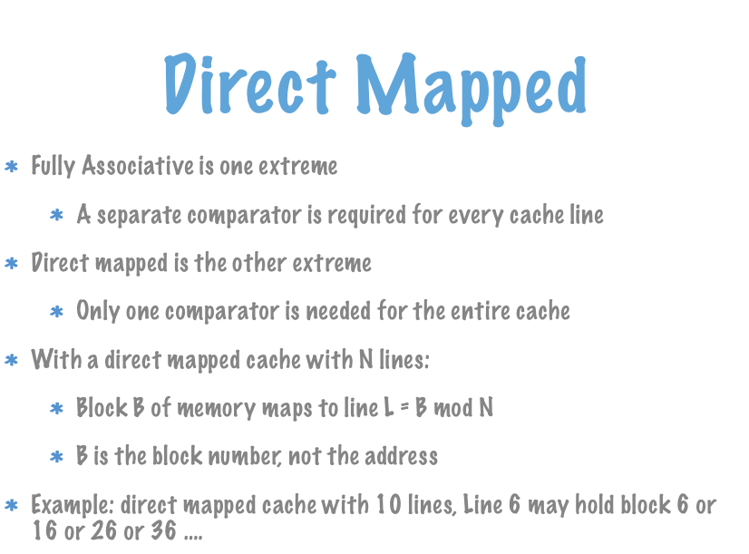
Direct Mapped

Slide 18
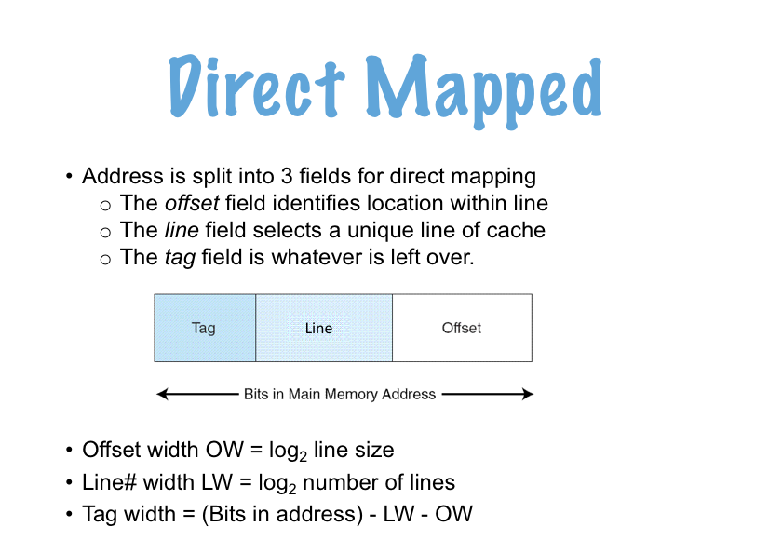
Direct Mapped

Slide 19
Example Problem 5
main memory
cache
address
0000
0001
0010
0011
0100
0101
0110
0111
1000
1001
1010
1011
1100
1101
1110
1111
A system has 2⁴ bytes of main memory and a direct mapped cache with 8 bytes.
A line is 2 bytes.
Address = 4 bits
Offset field = log(2) = 1 bit
Number of lines in cache =
(8 bytes/cache) / (2 bytes/line) = 4 lines/cache
Line field = log(4) = 2 bits
Tag field = 4 - 1 - 2 = 1 bit
For address 1010 what are the offset, line, and tag fields?
1010 = 1 01 0
tag = 1, line = 01, offset = 0
line | tag | data
00
01
10
11

Slide 20
Example Problem 5 Explanation
main memory
cache
address
0000
0001
0010
0011
0100
0101
0110
0111
1000
1001
1010
1011
1100
1101
1110
1111
A system has 2⁴ bytes of main memory and a direct mapped cache with 8 bytes.
A line is 2 bytes.
Address = 4 bits
Offset field = log(2) = 1 bit
Number of lines in cache =
(8 bytes/cache) / (2 bytes/line) = 4 lines/cache
Line field = log(4) = 2 bits
Tag field = 4 - 1 - 2 = 1 bit
For address 1010 what are the offset, line, and tag fields?
1010 = 1 01 0
tag = 1, line = 01, offset = 0
line | tag | data
00
01
10
11

Slide 21
Example Problem 6
cache
line | tag | data
00 | 1 | 0xACD7
01 | 0 | 0x1243
10 | 0 | 0xA398
11 | 1 | 0x72AC
Say the state of the cache described in the last slide is as shown.
The following memory addresses are requested. For each, is it a hit? If it is a hit, what is the data requested?
0xA
0xF
0x3

Slide 22
Example Problem 6 Step 1
cache
line | tag | data
00 | 1 | 0xACD7
01 | 0 | 0x1243
10 | 0 | 0xA398
11 | 1 | 0x72AC
Say the state of the cache described in the last slide is as shown.
The following memory addresses are requested. For each, is it a hit? If it is a hit, what is the data requested?
0xA
1010
tag = 1, line = 01, offset = 0 miss

Slide 23
Example Problem 6 Step 2
cache
line | tag | data
00 | 1 | 0xACD7
01 | 0 | 0x1243
10 | 0 | 0xA398
11 | 1 | 0x72AC
Say the state of the cache described in the last slide is as shown.
The following memory addresses are requested. For each, is it a hit? If it is a hit, what is the data requested?
0xF
1111
tag = 1 line = 11 offset = 1 --- hit
data = 0x72AC

Slide 24
Example Problem 6 Step 3
cache
line | tag | data
00 | 1 | 0xACD7
01 | 0 | 0x1243
10 | 0 | 0xA398
11 | 1 | 0x72AC
Say the state of the cache described in the last slide is as shown.
The following memory addresses are requested. For each, is it a hit? If it is a hit, what is the data requested?
0x3
0011
tag = 0, line = 01, offset = 1 --- hit
data = 0x1243

Slide 25
Example Problem 7
A system has a main memory with 2³² bytes and a direct mapped cache with 2¹² bytes and a block size of 2⁵ bytes.
What is the size of the address?
What is the size of the offset field?
What is the size of the line field?
What is the size of the tag field?

Slide 26
Example Problem 7 Answer
A system has a main memory with 2³² bytes and a direct mapped cache with 2¹² bytes and a block size of 2⁵ bytes.
What is the size of the address? 32 bits
What is the size of the offset field? log(2⁵) = 5 bits
What is the size of the line field? 2¹² bytes/cache / 2⁵ bytes/line = 2⁷ lines/cache
log(2⁷) = 7 bits
What is the size of the tag field? 32-7-5 = 20 bits

